Slide 1
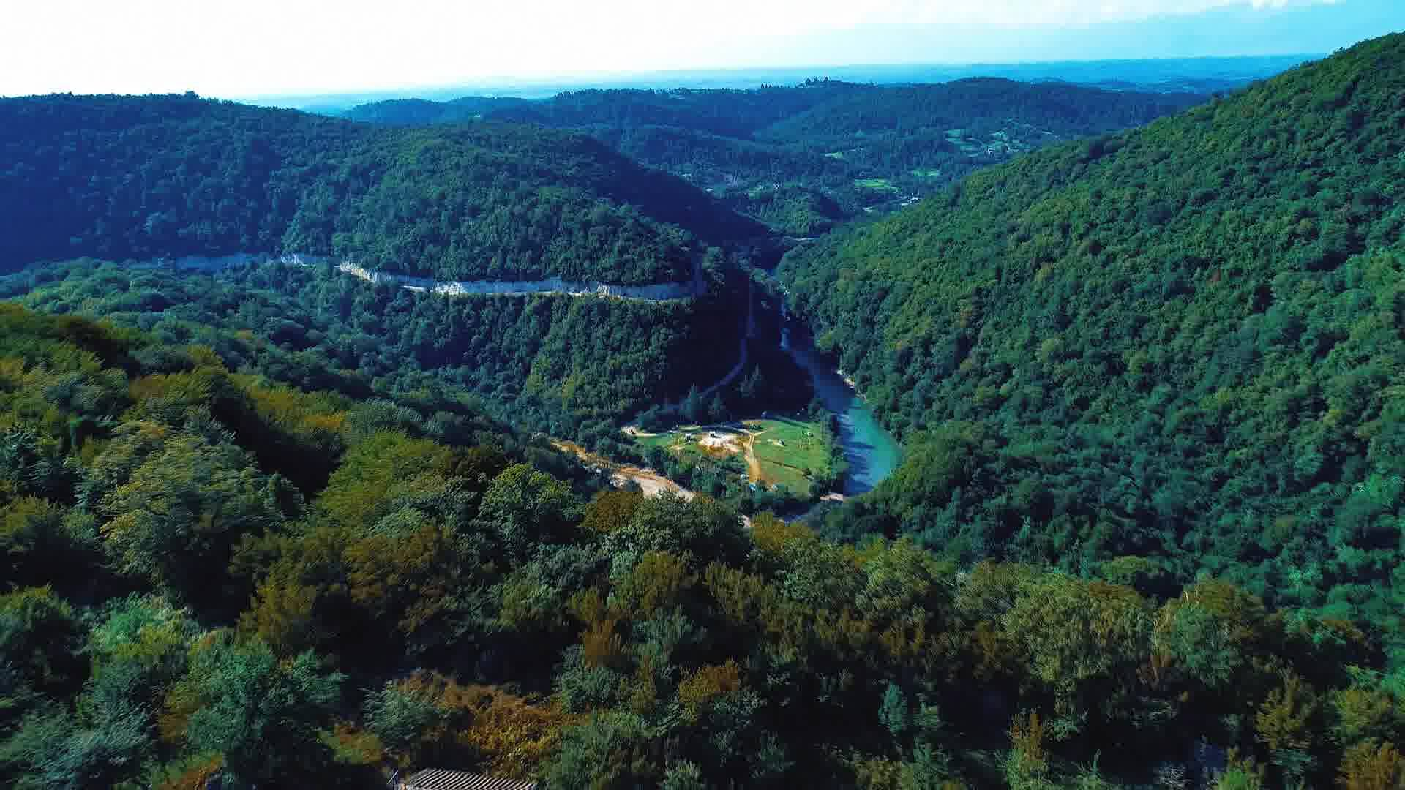
Energy Efficiency Project Concept
ECO
Senaki Municipality, Georgia

Slide 2
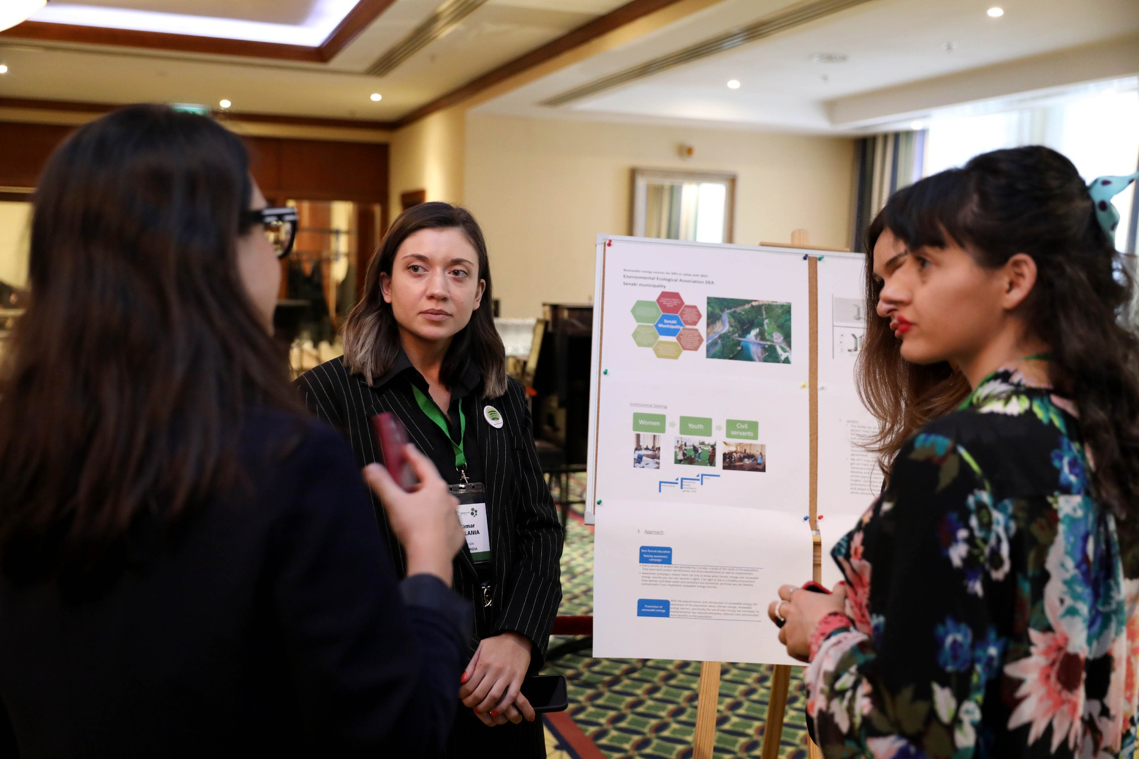
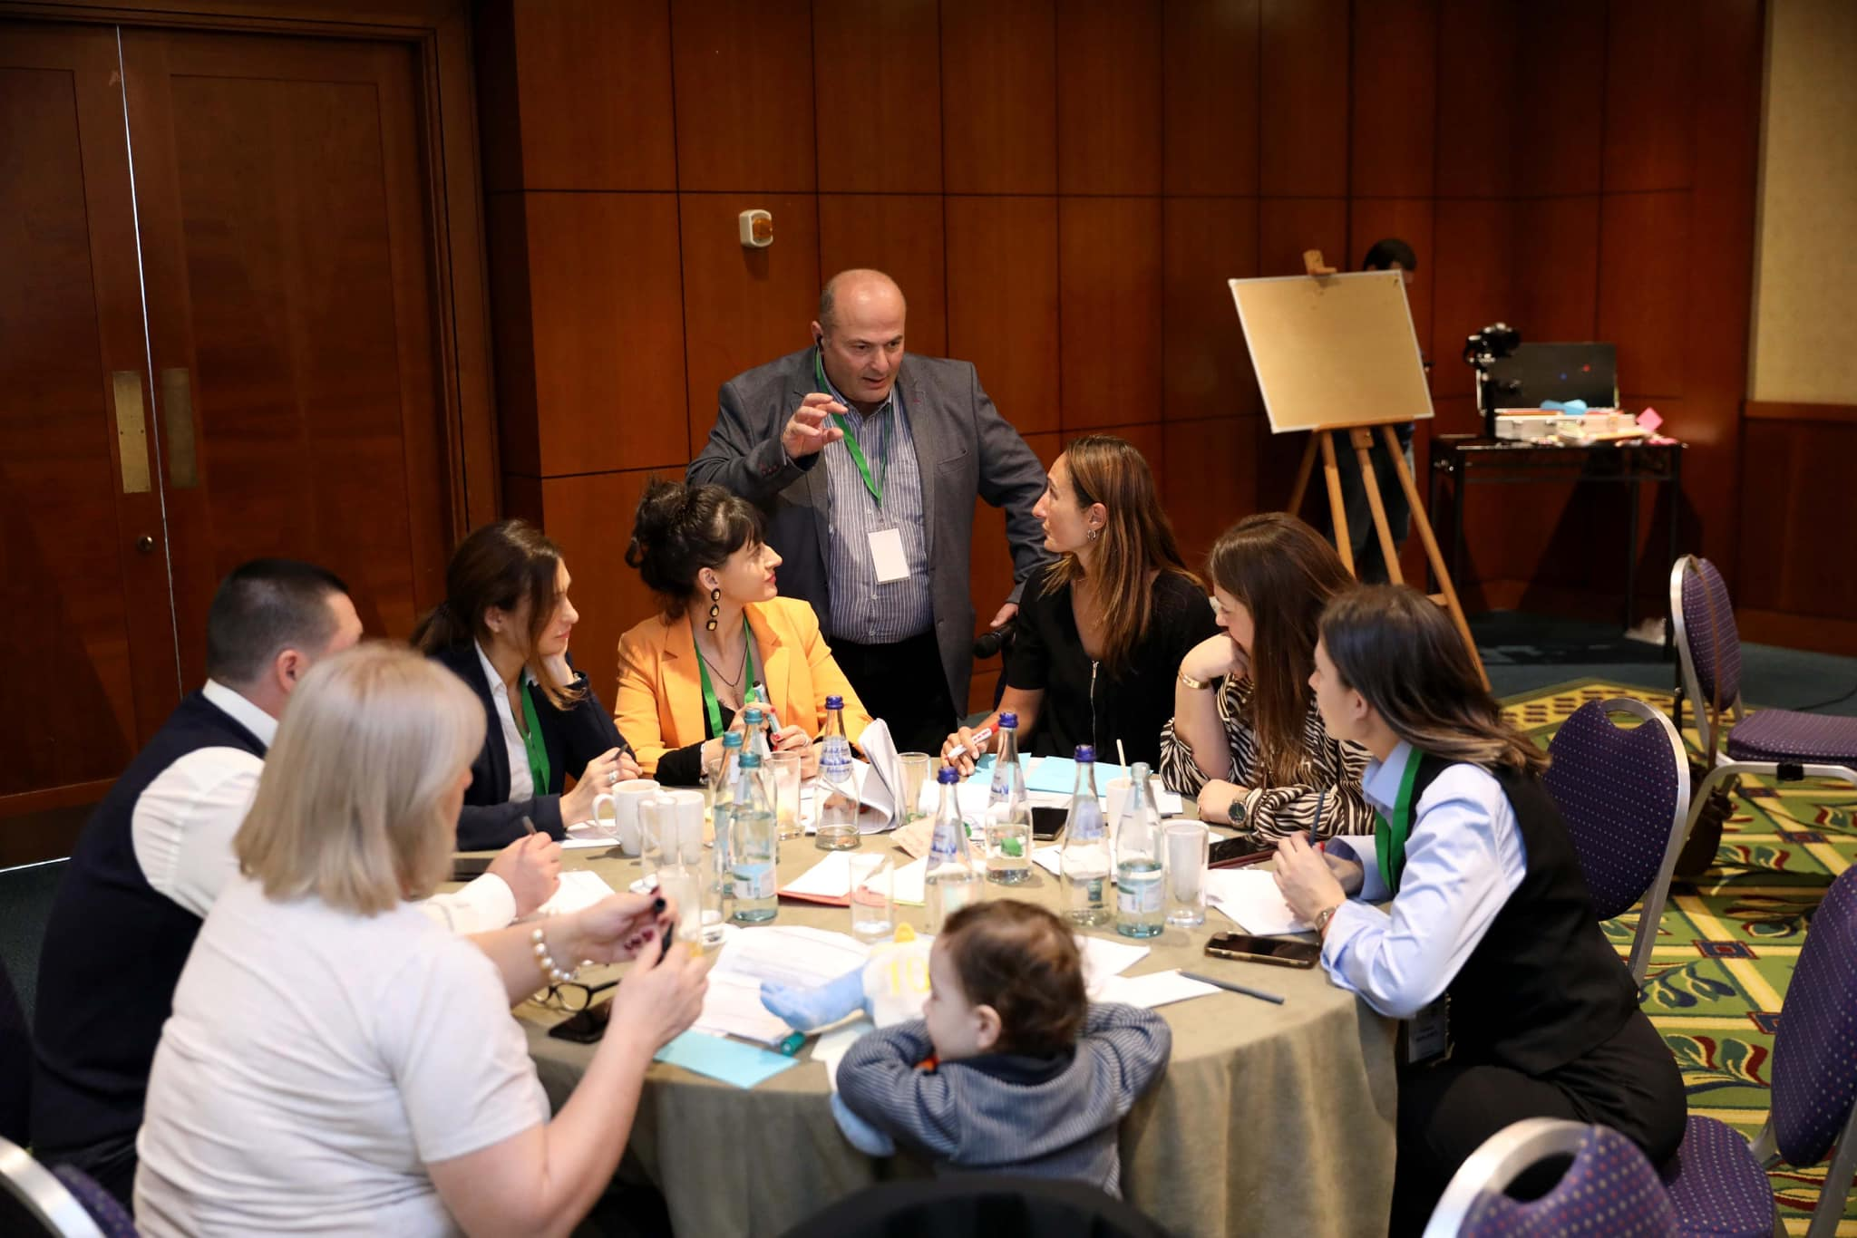
Explore the project- Dialogue event:
Renewable energy source on the Municipal level, Tbilisi Georgia
Participation of Senaki Municipality:
Exchange of experiences and know-how among experts in municipal practice.
Increase the participants' capacity to analyze existing challenges in municipal renewable energy action.
Good Practise - Renewable energy sources for IDPs in collaboration with NGO
Formulation of solution options for future planning.
Identification of future needs for project implementation and follow-up activities.

Slide 3
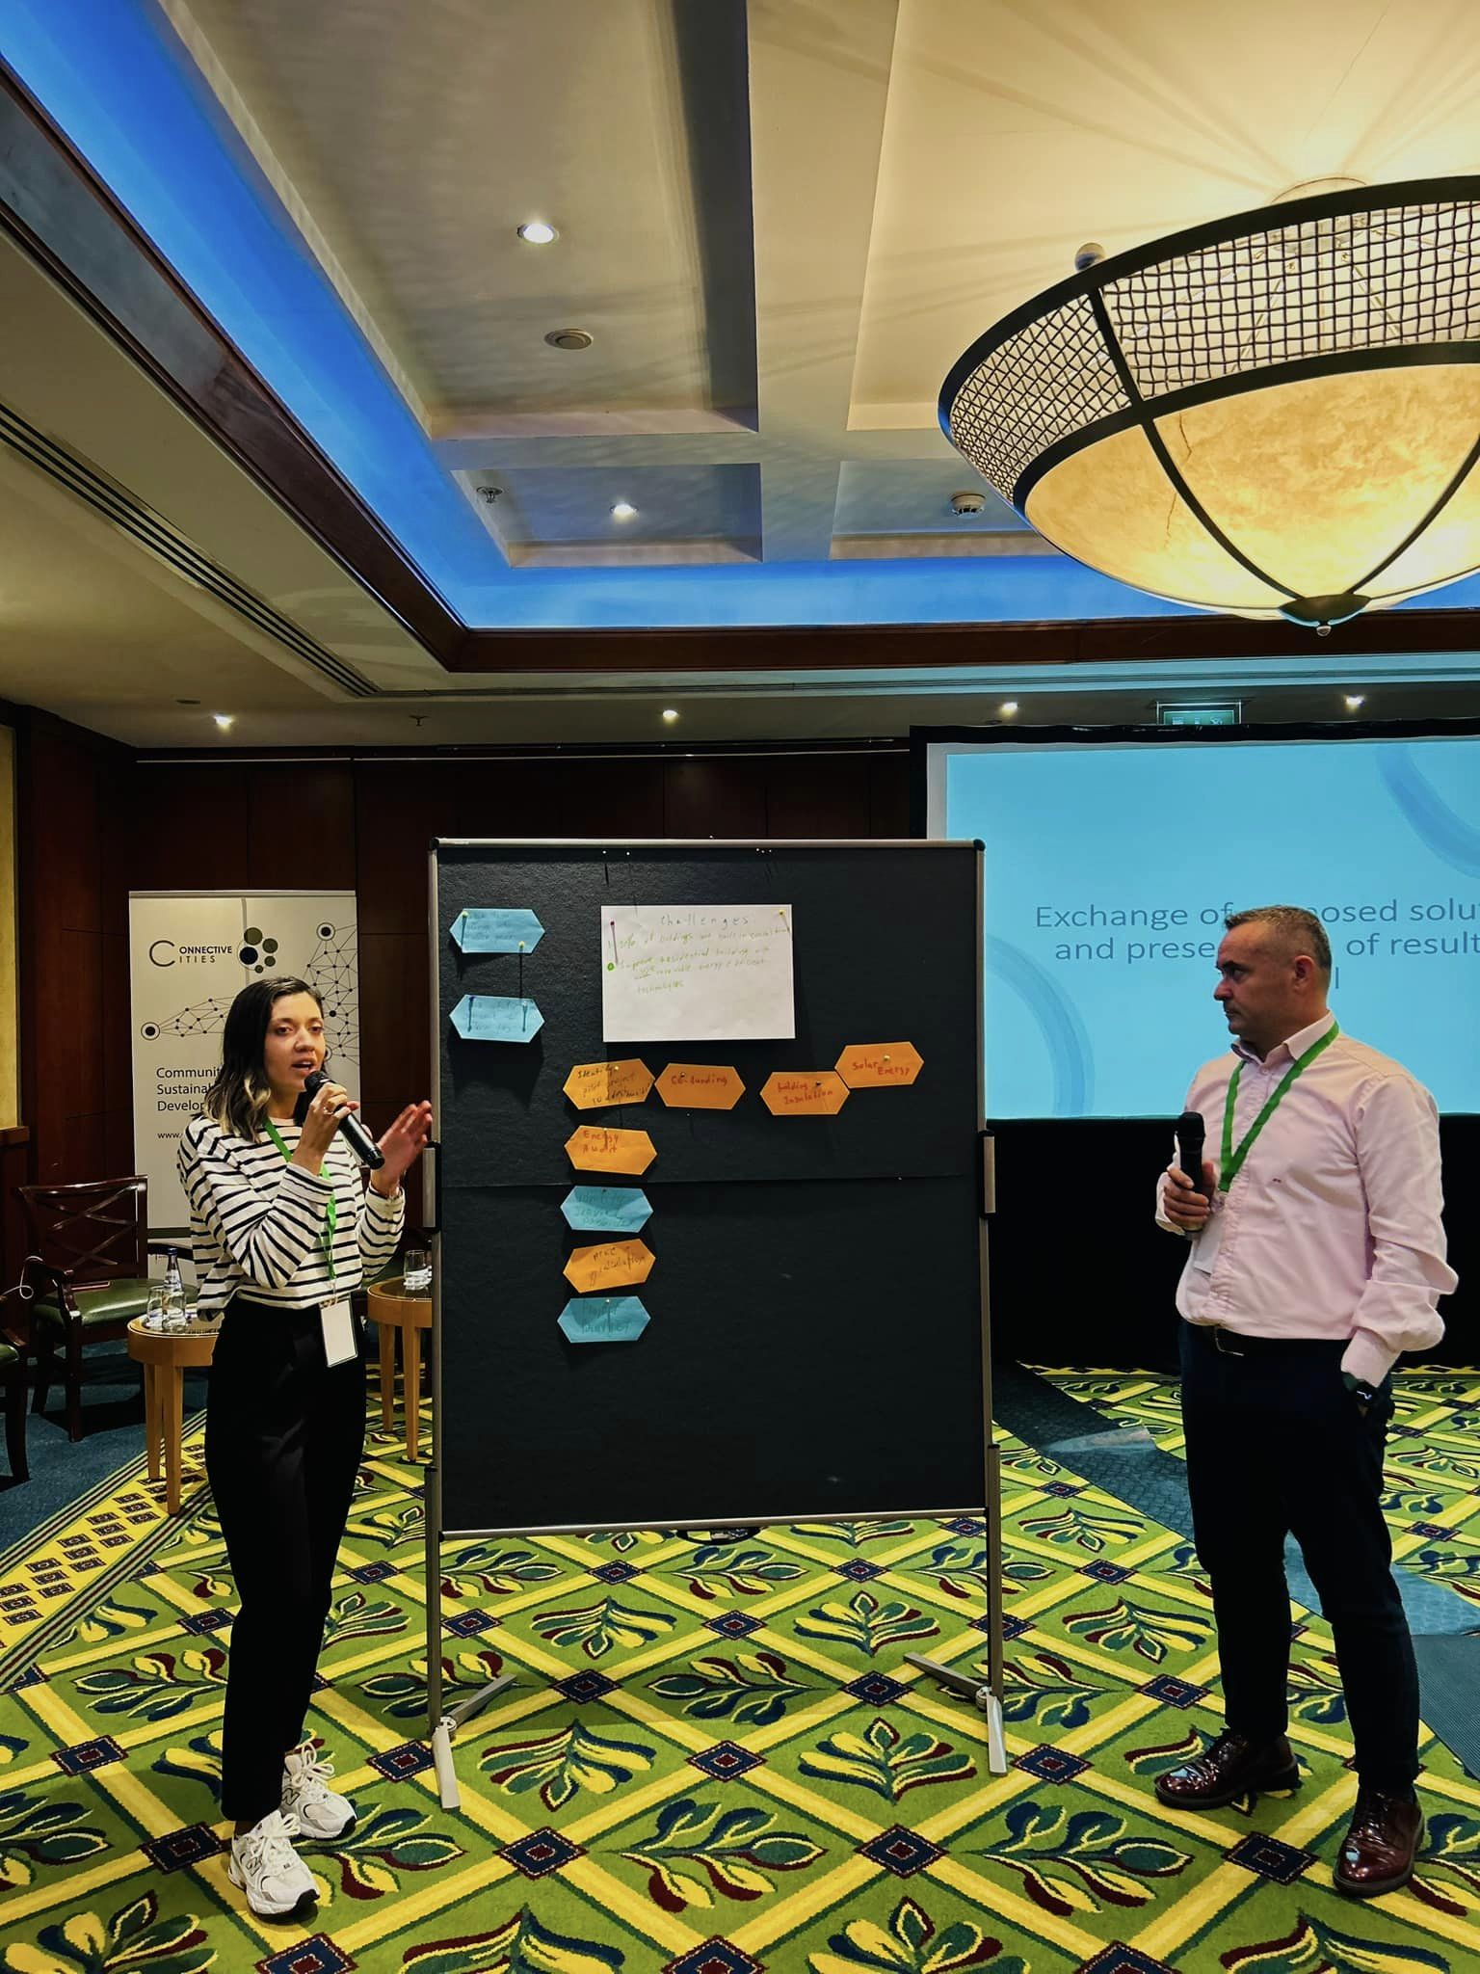
Exchange of proposed solutions & presentation of results in panel
Sneak peek
04
01
About the project
05
Project stages
02
Major requirements
03
Project goals
Problem: buildings of soviet period
Energy-efficiency for residential and municipal buildings
Under the funded funding
Develop building, which is adapted energy-efficiency
Short communal fees, introduction, and popularization of energy–efficiency technologies

Slide 4
Project feedback
Meeting discussion
Dialogue event Update
Project concept note

Slide 5
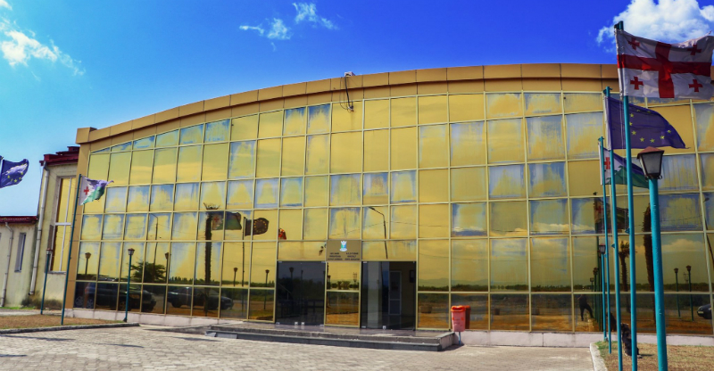
Architecturally beautiful building, built in 2008.
Up to 50 people per day participate for work and sports.
The roof has been damaged due to the dangers caused by climate change
The building is non-energy efficient
Now
We have taken into account the advice of the project team and have ordered an energy audit of the building, which will allow us to move on to the next stage of the project
We prepared a project concept note for Sport Complex Senaki, which includes Roof replacement with warming sun substation insulation and solar water heater

Slide 6
Future
By fully implementing the project, we will get the first energy-efficient building in the industrial region, which uses solar energy, saves financial resources, is adapted to all types of people, and reduces emissions from the atmosphere.
When we complete the energy audit of the building, we need to call donors, support organizations, because this project requires a lot of financial resources. Local authorities have been able to co-finance but cannot cover the total costs.

Slide 7
Reducing Emissions
In 2019, the total final energy consumption for Senaki municipality in different sectors such as buildings (municipal, non-municipal/tertiary, domestic) transport (municipal fleet),
And lighting, amounted to 190,377.1 MWh.
Accordingly, the largest consumer of energy is the residential sector - 177,634.4 MWh, followed by the municipal sector - 8,055.1 MWh (buildings & lighting), followed by the non-municipal/tertiary sector - 2884.71 MWh, and the transport sector - 1802,91 MWh considering that only the municipal car fleet is represented
SEKAP takes into account the perspective of the development of Senaki Municipality and the necessary growth in 2030-2050, taking into account the increase in emissions and the demand for energy resources.
This growth is considered in the business as usual (BAU) scenario, in which emissions are reduced as a result of the introduction and implementation of various mitigation and adaptation measures.
Therefore, the final reduction target by at least 35% refers to (𝑬𝒎𝒊𝒔𝒔𝒊𝒐𝒏𝑪𝑶𝟐 𝟐𝟎𝟑𝟎) emissions by 2030 also according to the BAU scenario

Slide 8
Major requirements
Financial Support
Energy audit
We hope, Connective Cities will help us connect with foundations and donor organizations.
Implemented by funding local governance

Slide 9
How to be more efficient
Insulation
Energy-efficient roof
Solar Power Plant
Solar Water Hinter

Slide 10
Act now for energy efficiency!

Slide 11
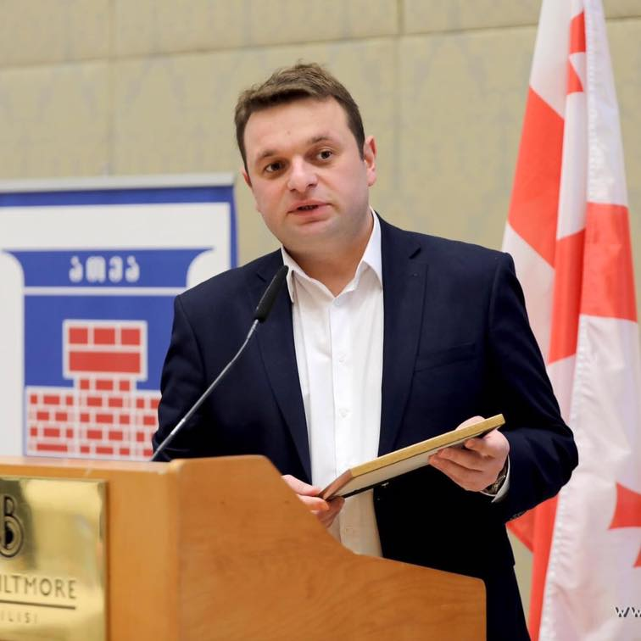
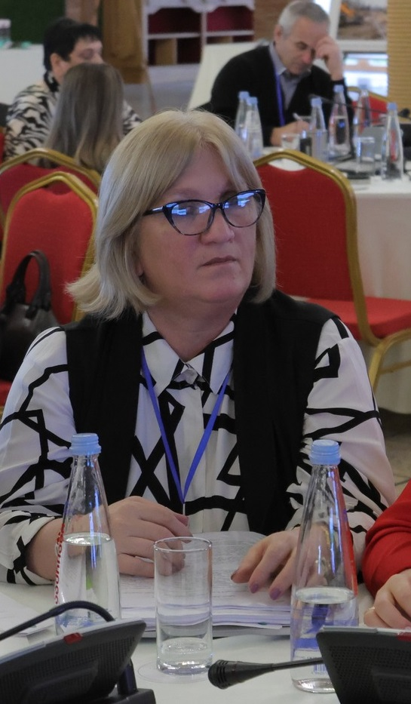
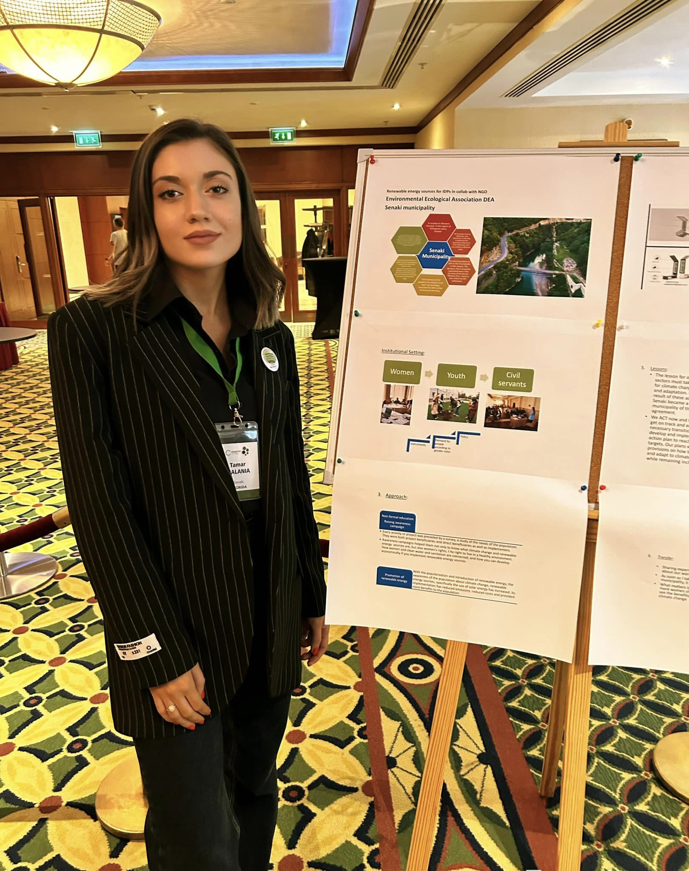
Our team
Vakhtang Gadelia
Tamar Malania
Dali Kachibaia
Mayor of Senaki Municipality, Head of WG of CoM-East
Advisor to Mayor
Co-head of WG CoM-East

Slide 12

Thanks
Do you have any questions?
Follow the project updates
takomalania@gmail.com
+995 598289595
www.senaki.gov.ge

